Slide 1
The Rivers of Bangladesh
Lifelines of a Nation

Slide 2
Overview of Rivers in Bangladesh
Brief introduction about Bangladesh as a riverine country.
Mention the Significance of rivers in it’s culture, economy and geography.
Image of the river network of Bangladesh

Slide 3
Major Rivers of Bangladesh
Highlight the key revers
Padma River
Jamuna River
Meghna River
Brahmaputra River
Ganges River

Slide 4
Importance of Rivers
Economic Importance
Agriculture (irrigation and fertile soil).
Fisheries.
Transportation and trade.
Environmental Importance
Biodiversity hotspots.
Role in the ecosystem and floodplain replenishment.

Slide 5
Challenges Facing Rivers
Pollution
Industrial and domestic waste.
Climate Change
Floods, Droughts, and rising sea levels.
Riverbank Erosion
Displacement of communities.

Slide 6
Cultural and Religious Significance
Rivers in Bengali literature, songs and folklore.
Religious ceremonies and festivals associated with rivers.

Slide 7
Climate change and future challenges
Rising Sea levels: Due to climate change, the rising sea level could affect the sea level could affect the salinity and water levels of rivers, posing a long-term risk to Bangladesh.
Extreme weather Events: The increased frequency of extreme events like floods, cyclones, and droughts could have further impacts on the river systems.

Slide 8
River Management and Government Efforts
National River Conservation commission(NRCC):
You could cover government policies and the NRCC’s role in preserving and managing river resources.
International Agreements:
Bangladesh shares many rivers with neighboring India. Discuss the role of international agreements (e.g., the Ganges Water Treary) in managing shared river resources.

Slide 9
Solutions and Future Prospects
Sustainable river management practices.
Awareness campaigns for reducing pollution.
Government and NGO initiatives for conservation.
Potential for ecotourism.

Slide 10
Conclusion
Recap the importance of rivers Bangladesh.
Call to action for conservation efforts.

Slide 11
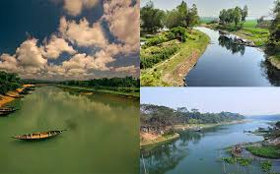
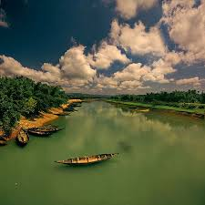
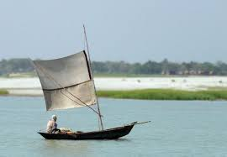
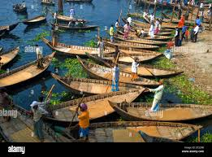
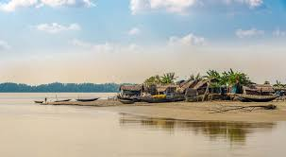
Picture of River in Bangladesh

